Slide 1

Assessment of Facial Expression in Product Testing
Supervised by:
Dr.Muazzam Maqsood
Group Members:
Areej Jamil(FA17-BCS-087)
Manahil Sajjad (FA17-BCS-105)
Department of Computer Science
COMSATS University Islamabad, Attock Campus

Slide 2
Outline
Introduction
Problem statement
Objectives
Methodology
Comparison Table
Modern tools
Benefits
Diagrams
Application Screenshots
References

Slide 3
Introduction
Trying to inspect a person's emotional state in a nonverbal form requires decoding his/her facial expression .
Many times, body language especially facial expressions tell us more then words.
Our project is about KNOWING WHAT CUSTOMER WANTS or what it does not want ,we will predict it by examining the facial features of the customers when he/she is introduce to a new product we aims to automatically estimate the levels of liking through facial expression , though capturing videos rather than using handcraft features.

Slide 4
Problem statement
Understanding and assessing the customer’s emotional response in relation to products/service before lunching .
Introduce to a new product we aims to automatically estimate the levels of liking through facial expression, though capturing videos rather than using handcraft features.

Slide 5
Objectives
Our objective is to investigate human emotion in real-time about a product before launching.
To collect the data set for human face expressions during testing a product.
To predict the expression of human as accurately as possible.
To implement the facial detection and recognizing system through machine learning using video recording as input.

Slide 6
Methodology
Face Detection:
We used Cascading Classifiers To detect face in video.
Feature Extraction:
Facial feature extraction is the process of extracting expressions component features like teeth reveling , eyebrows rising , open mouth etc. from human face by using the Haar feature classifier to extract features of the original data and then process the extracted features.
Expression recognition:
Anger: it involves three main features teeth reveling eyebrows down and inner side tightening, quenching eyes.

Slide 7
Continued..
Surprise: very similar to the feature of fear. Maybe because a surprising situation can frighten for a brief moment .
Sadness: it involve a slight pulling down of lip corners, inner side of eyebrow is rising.
Happiness: it involves the smile both corners of mouth rising.
Fear: it involves widened eyes and sometimes open mouth.

Slide 8
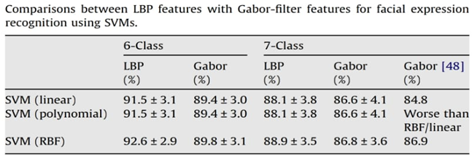
Related Work/Comparison Table

Slide 9
Modern tools
Java Programming Language (Building block for android programming)
Android Studio & SDK (Designing and Development)
Firebase ,DJANGO,SQL (Knowledge of Basic Queries)
Basic concepts of python (For machine learning)
Learning algorithms for Machine Learning.
Pycharm,Jupiter Notebook (For implementation of Machine Learning algorithms using python)
A smartphone (For testing)

Slide 10
Benefits
To help companies brands to identify customers interested in product that can earn more.
Introduce a new product we aims to automatically estimate the levels of liking through facial expression , though capturing videos rather than using handcraft features.

Slide 11
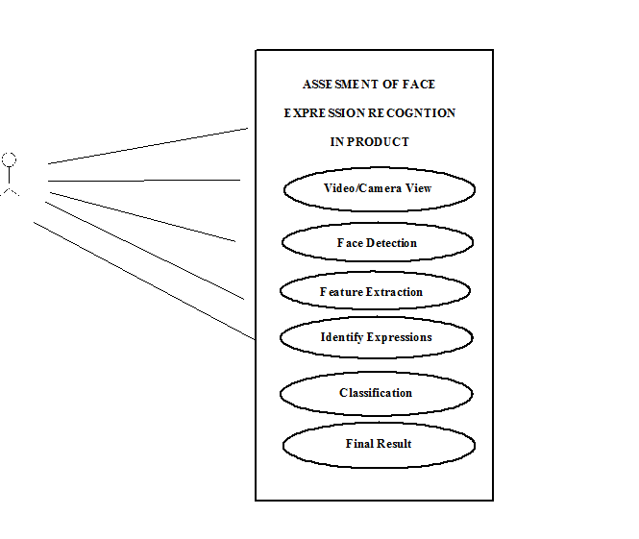
Use case Diagrams:

Slide 12
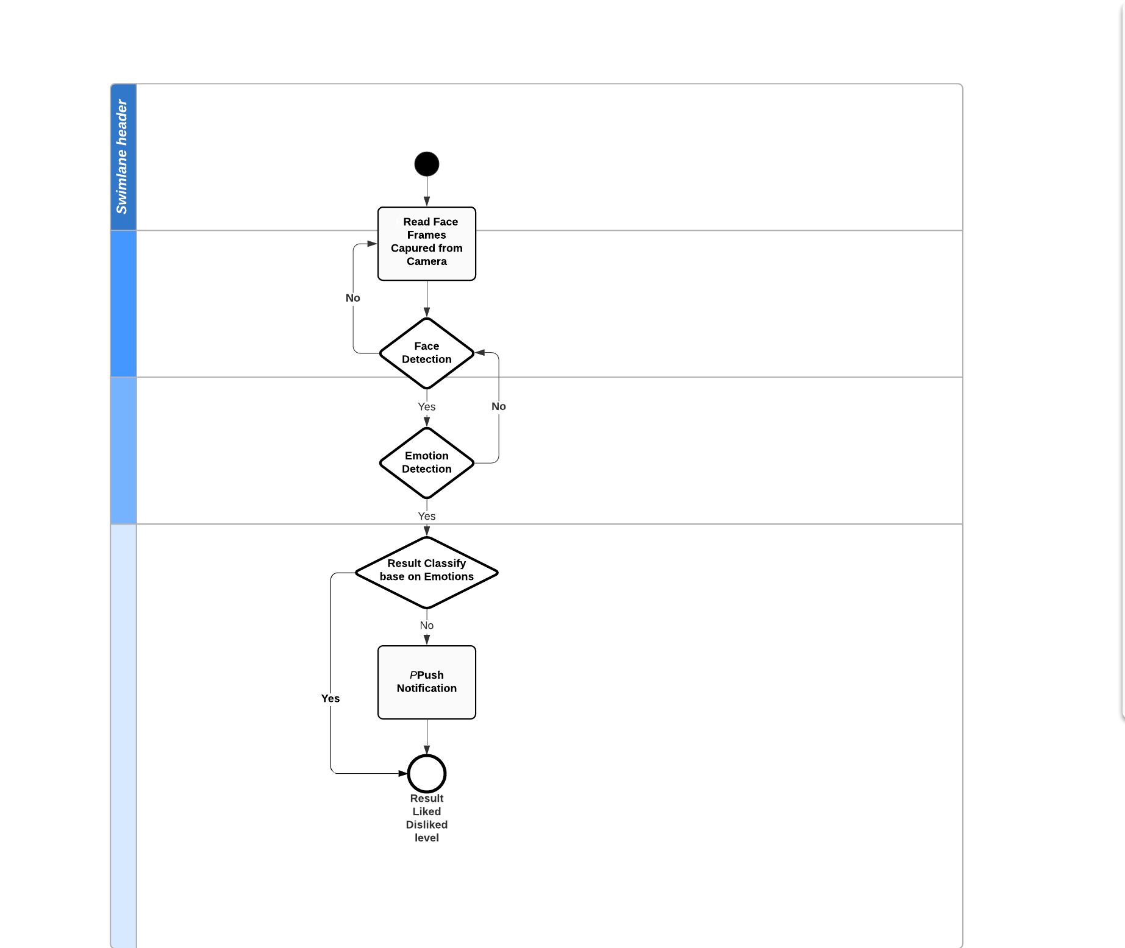
Activity Diagrams:

Slide 13
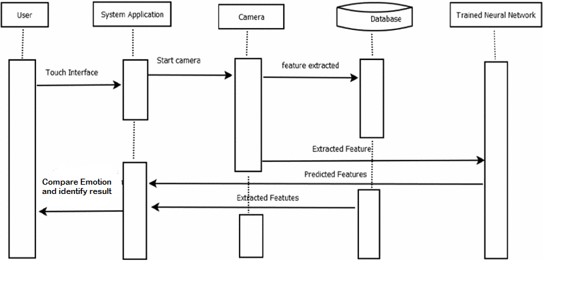
Sequence Diagram:

Slide 14

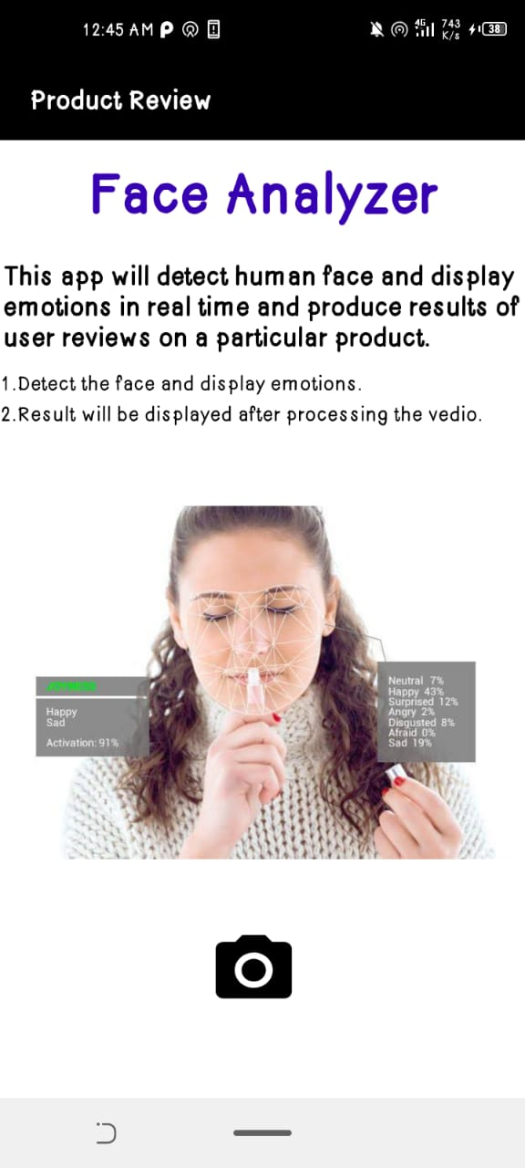
Screenshoots

Slide 15
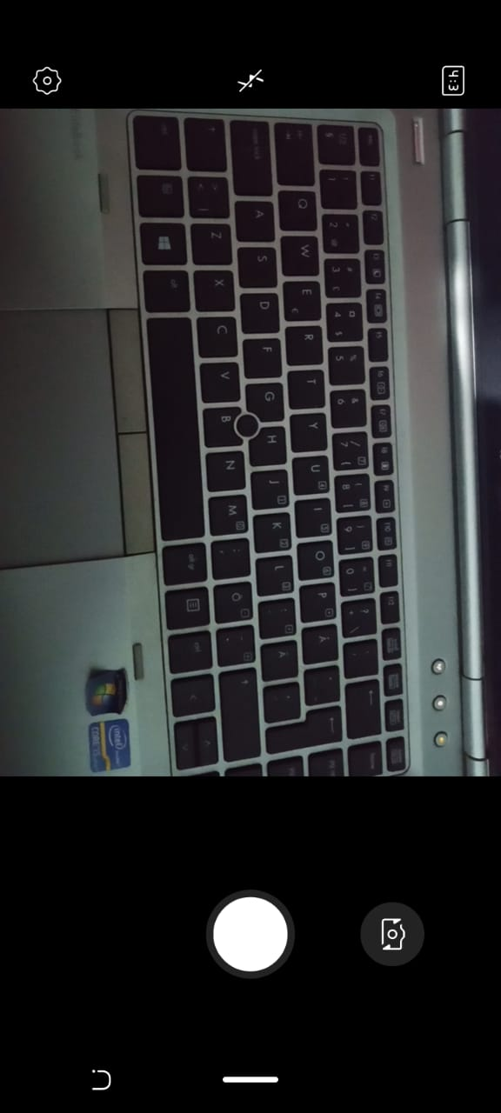
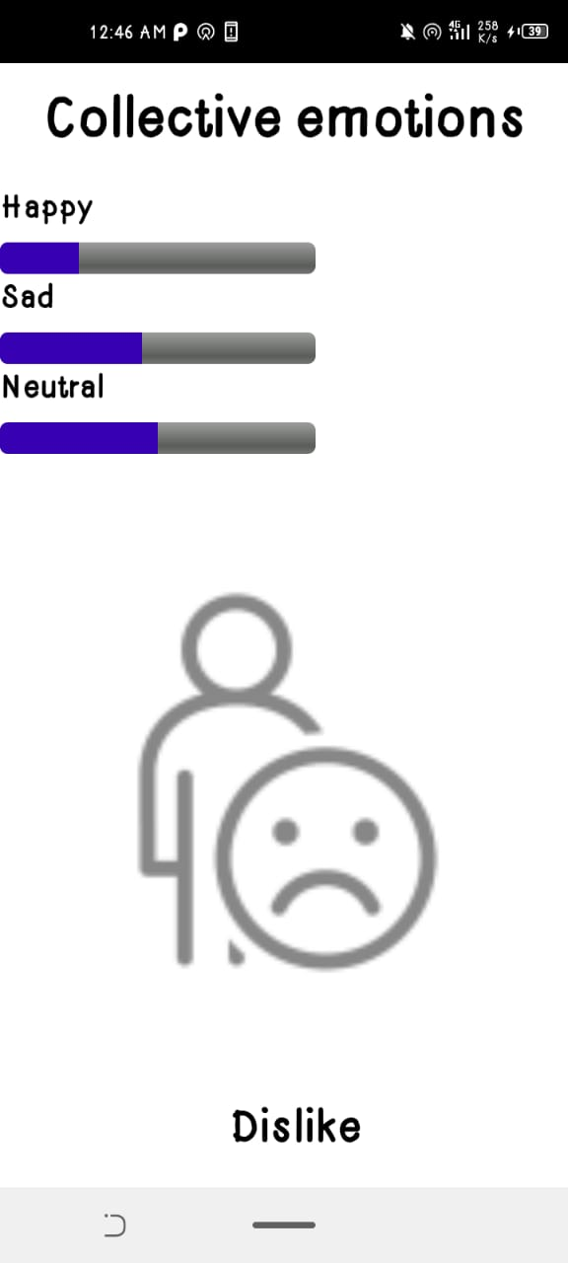
Screenshoots

Slide 16
References
Facial Expression Detection Using FACS. https://www.ijser.org/researchpaper/Facial-Expression-Detection-Using-FACS.pdf
IMAGE PROCESSING FACIAL EXPRESSION RECOGNITION. https://rcciit.org/students_projects/projects/it/2018/GR8.pdf
Going Deeper in Facial Expression Recognition using Deep .... https://deepai.org/publication/going-deeper-in-facial-expression-recognition-using-deep-neural-networks
Vision Based Hand Gesture Recognition for Indian Sign .... http://www.internationaljournalssrg.org/uploads/specialissuepdf/ICETSST-2017/2017/CSE/1-%20litle%20copy.pdf
SRS-sdar - Studylib. https://studylib.net/doc/25218753/srs-sdar
Energy Storage and Microgrid Training and Certification .... https://www.necanet.org/docs/default-source/NECA2016Presentations/e-21_28-energy-storage-and-micro-grid-training-initiative.pdf?sfvrsn=2
Naive Bayes Classifier in Machine Learning - Javatpoint. https://www.javatpoint.com/machine-learning-naive-bayes-classifier
Recognizing human facial expressions with machine learning .... https://www.thoughtworks.com/insights/articles/recognizing-human-facial-expressions-machine-learning

